Slide 1
CPAM0066
NM_001173543.1(BANP): c.1372G>A, p.Val458Met

Slide 2
Nominated by | Dr. Kai Jia and Dr. Anna Hurst (UAB)
Phenotype | Double-outlet right ventricle (congenital heart defect) Severe combined immunodeficiency
Sequencing | Trio WGS at HudsonAlpha Clinical Services Laboratory
Candidate variant | NM_001173543.1(BANP): c.1372G>A, p.Val458Met (Het; De novo; VUS)
ACMG classification | Variant of uncertain significance (PS2, PM2)
Model of interest | Mouse
Goals | ACMG classification on causality Functional impact confirmation Downstream applications (research focused) Testing potential treatment options
Secondary sequencing result | KCNH2 c.1979C>T, p.Ser660Leu Variant has conflicting interpretations of pathogenicity Observed in individuals suspected to have long QT syndrome and several individuals referred for long QT syndrome genetic testing This participant has one normal and one borderline measurement on EKGs

Slide 3
Clinical History
35w6d gestation, spontaneous labor, vaginal delivery, Apgars 7/9, BW 2140g
Pregnancy complicated by maternal hypertension
Heart murmur noted at birth, hypoxia: Double outlet right ventricle (DORV), moderate pulmonic stenosis, mild aortic insufficiency, small patent ductus arteriosus
Newborn screen positive for severe combined immunodeficiency (SCID), confirmed on further testing

Slide 4
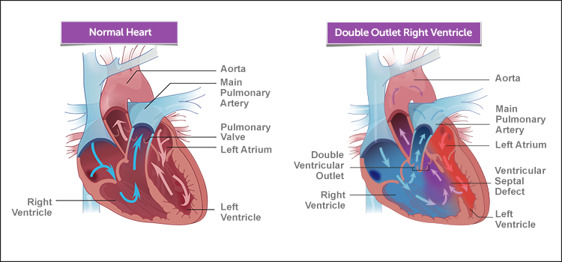
Double Outlet Right Ventricle
https://www.childrenshospital.org/conditions-and-treatments/conditions/d/dorv

Slide 5
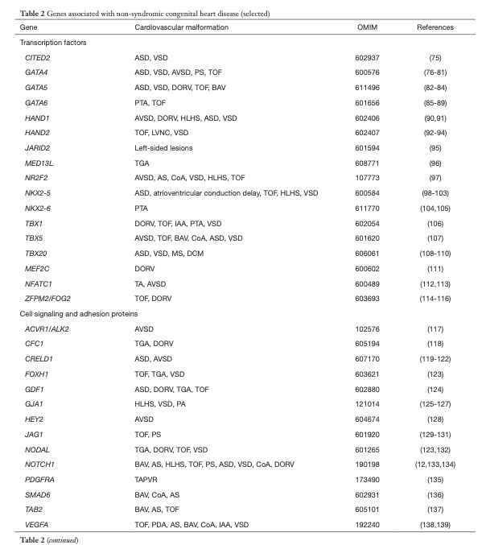
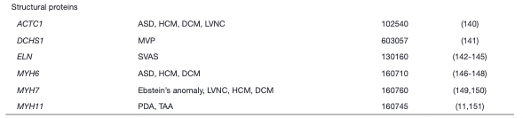
Genes Associated with Nonsyndromic CHD

Slide 6
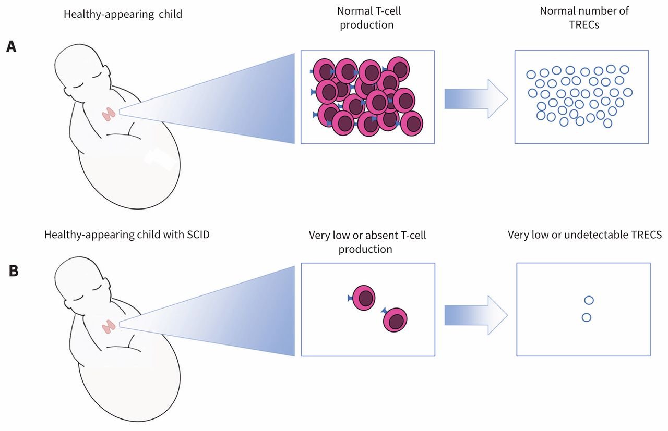
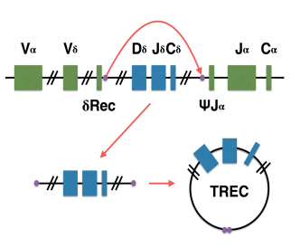
Newborn Screening for SCID
TREC: T-cell receptor excision circle
https://azdhs.gov/documents/preparedness/state-laboratory/newborn-screening/scid-event/nbs-scid-poster.pdf
https://www.cmaj.ca/content/189/50/E1551

Slide 7
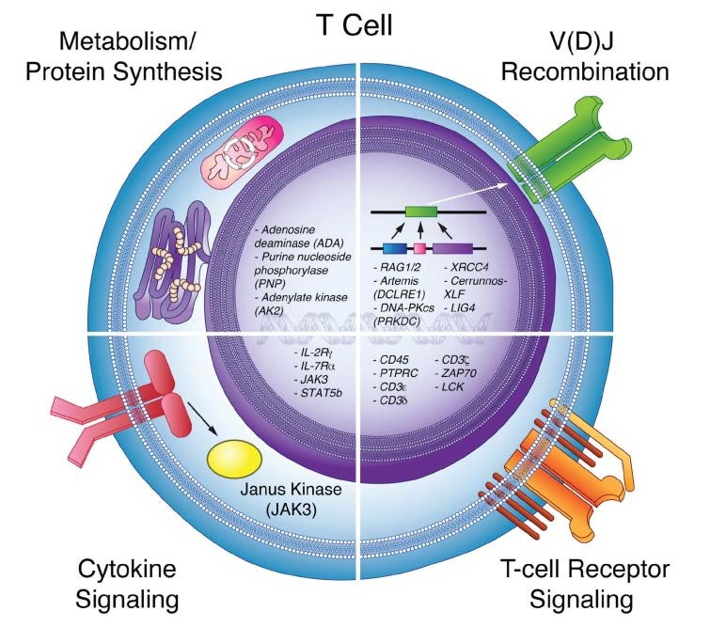
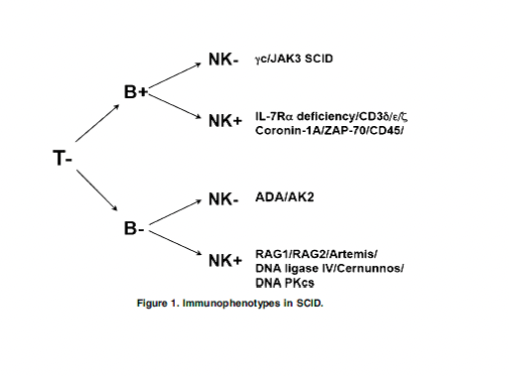
Types of SCID
https://starship.org.nz/guidelines/severe-combined-immunodeficiency-scid/
https://azdhs.gov/documents/preparedness/state-laboratory/newborn-screening/scid-event/nbs-scid-poster.pdf

Slide 8
ACMG Classification
Variant
NM_001173543.1(BANP): c.1372G>A, p.Val458Met (Het; De novo; VUS)
Current classification: Variant of uncertain significance
Criteria
Confirmed:
PS2 - De novo (both maternity and paternity confirmed) in a patient with the disease and no family history
PM2 - Absent from controls in Exome Sequencing Project, 1000 Genomes or ExAC
Potential criteria to add to interpretation (with a model):
PS3 - in vitro or in vivo functional studies supportive of a damaging effect on the gene or gene product
PS2 + PM2 + PS3= Likely Pathogenic/Pathogenic reclassification

Slide 9
HPO Terms and Affected Systems
CARDIOVASCULAR
Double outlet right ventricle with subaortic ventricular septal defect and pulmonary stenosis (HP:0011655)
Aortic insufficiency (HP:0001659)
Patent ductus arteriosus (HP:0001643)
Pulmonary valve defects (HP:0005148)
IMMUNE SYSTEM
Severe combined immunodeficiency (HP:0004430)
  Primary defect leading to SCID is severe T-cell immunodeficiency (HP:0005352)

Slide 10
BANP Summary
BANP (BTG3 Associated Nuclear Protein)
Aliases: SMAR1, BEND1
Expression: BANP expression is ubiquitous. However, expression is high in the thymus, heart, and spleen compared to other organs.²
Biological Processes
Chromatin organization
  BANP is a matrix attachment region (MAR) binding protein (MARBP).¹
Transcription regulation
  BANP interacts with several key transcription factors like p53, NF-κB, and other co-regulatory factors to regulate the expression of a plethora of genes involved in various cellular pathways (cell cycle, apoptosis, and cellular signaling). ¹
  BANP as a CGI (CpG island) controlling transcription factor.³
  Maintains a fine-tuned balance between effector CD4+ T cells and Treg cells by influencing the transcription factors during allergic and autoimmune inflammatory diseases. ⁵
T-cell development
  BANP controls V(D)J recombination during T-cell development by repressing T-cell receptor (TCR) beta enhancer function. ⁴
Notes:
Additional notes
Chromatin organization - MARs are DNA sequences where loops of DNA are tethered to the nuclear matrix. MARBPs bind these MAR sequences and thus interact with numerous regulatory and chromatin-modifying factors resulting in the assembly and organization of nuclear microenvironments that govern gene transcription.
Transcription - BANP is a strong CGI activator that controls essential metabolic genes in pluripotent stem and terminally differentiated neuronal cells.
1. Malonia, S.K., Sinha, S., Lakshminarasimhan, P., Singh, K., Jalota-Badhwar, A., Rampalli, S., Kaul-Ghanekar, R., and Chattopadhyay, S. (2011). Gene regulation by SMAR1: Role in cellular homeostasis and cancer. Biochim. Biophys. Acta 1815, 1–12.
2. Birot, A., Duret, L., Bartholin, L., Santalucia, B., Tigaud, I., Magaud, J., and Rouault, J. (2000). Identification and molecular analysis of BANP. Gene 253, 189–196.
3. Grand, R.S., Burger, L., Gräwe, C., Michael, A.K., Isbel, L., Hess, D., Hoerner, L., Iesmantavicius, V., Durdu, S., Pregnolato, M., et al. (2021). BANP opens chromatin and activates CpG-island-regulated genes. Nature 596, 133–137.
4. Kaul-Ghanekar, R., Majumdar, S., Jalota, A., Gulati, N., Dubey, N., Saha, B., and Chattopadhyay, S. (2005). Abnormal V(D)J recombination of T cell receptor beta locus in SMAR1 transgenic mice. J. Biol. Chem. 280, 9450–9459.
5. Mirlekar, B., Gautam, D., and Chattopadhyay, S. (2017). Chromatin remodeling protein SMAR1 is a critical regulator of T helper cell differentiation and inflammatory diseases. Front. Immunol. 8, 72.

Slide 11
Novelty of a BANP model
Exact function of this gene during cardiovascular development and in immunological responses is not well known.
Comparison of BANP functions between two different systems will help us better understand its cell/tissue specific activities, which can be invaluable for future drug development that specifically targets one system.

Slide 12
Application(s) of the Model
Dr. Jiao's research plan:
Focus on cardiovascular development (but open to immunology collaboration)
Use the model(s) generated by CPAM to determine the potential role of BANP in different cardiovascular cell types, like cardiomyocytes, neural crest cell, endocardial cell, epicardial cells, smooth muscle cells.
Examine how this mutant allele (and/or conditional deletion of this gene) affects proliferation, survival, migration and differentiation of these cell types.
Apply a high throughput approach to examine the transcriptome and epigenome of these cells in control and mutant embryos.
Based on the results acquired from examination of mouse models, establish in vitro functional tests using relevant cell types, and such tests will serve as the platform for future drug testing and screening.

Slide 13
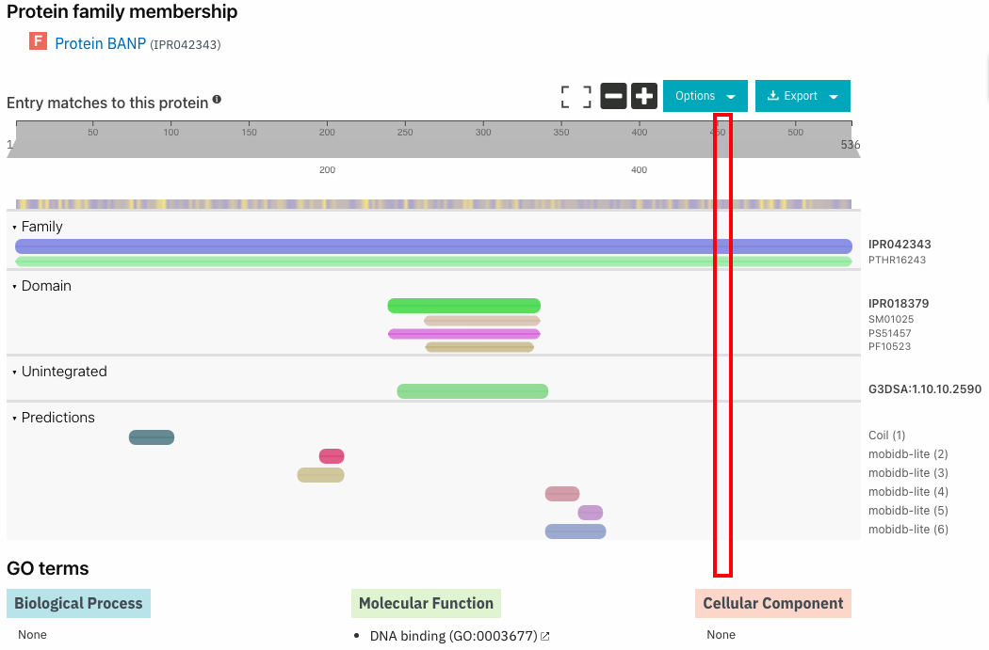
Secondary Structure

Slide 14
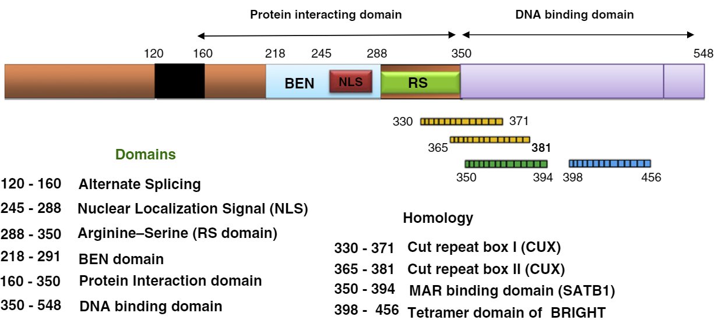
Functional Domains of BANP
Notes:
Malonia, S.K., Sinha, S., Lakshminarasimhan, P., Singh, K., Jalota-Badhwar, A., Rampalli, S., Kaul-Ghanekar, R., and Chattopadhyay, S. (2011). Gene regulation by SMAR1: Role in cellular homeostasis and cancer. Biochem. Biophys. Acta 1815, 1–12.

Slide 15
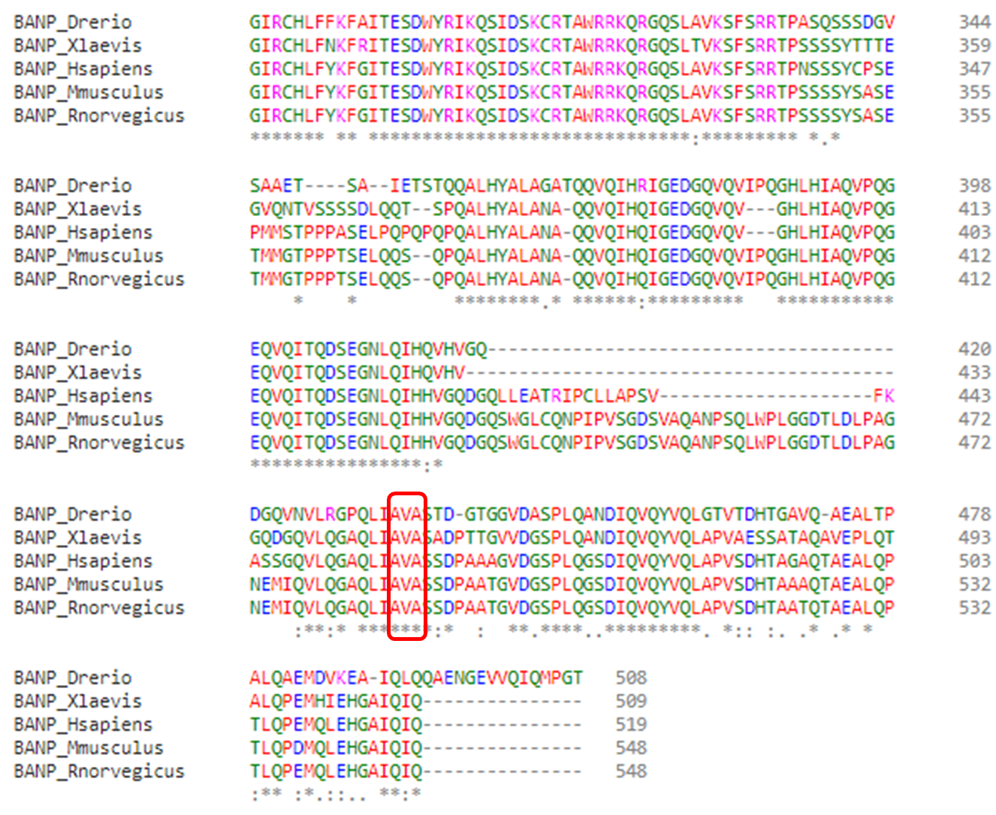
Gene homology/multiple sequence alignment

Slide 16
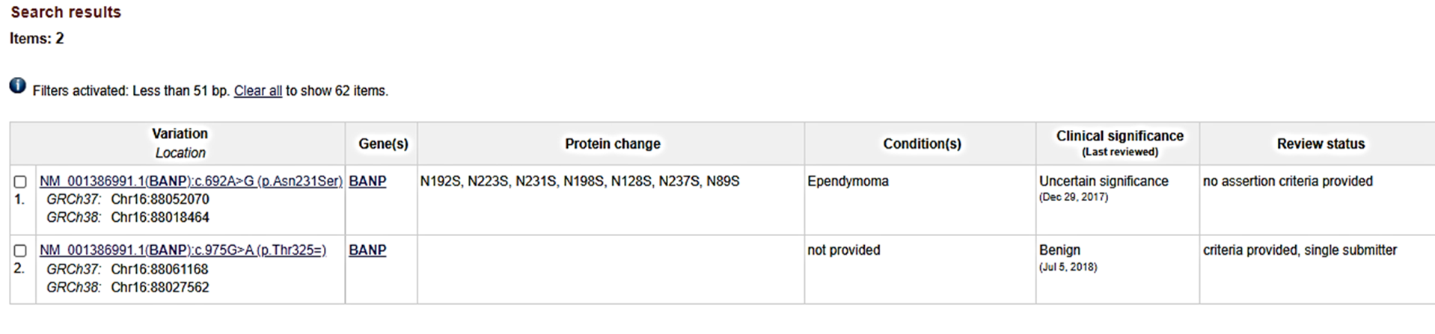
Other causal variation in this locus (ClinVar/disease specific DB/OMIM)
ClinVar:
Conflicting interpretations(0)
Benign(1)
Likely benign(0)
Uncertain significance(1)
Likely pathogenic(0)
Pathogenic(0)
Risk factor(0)
Note potential impact of low complexity and repetitive regions in accurate variant calling and interpretation...
Regional deletion including this gene and many others has been reported as pathogenic

Slide 17
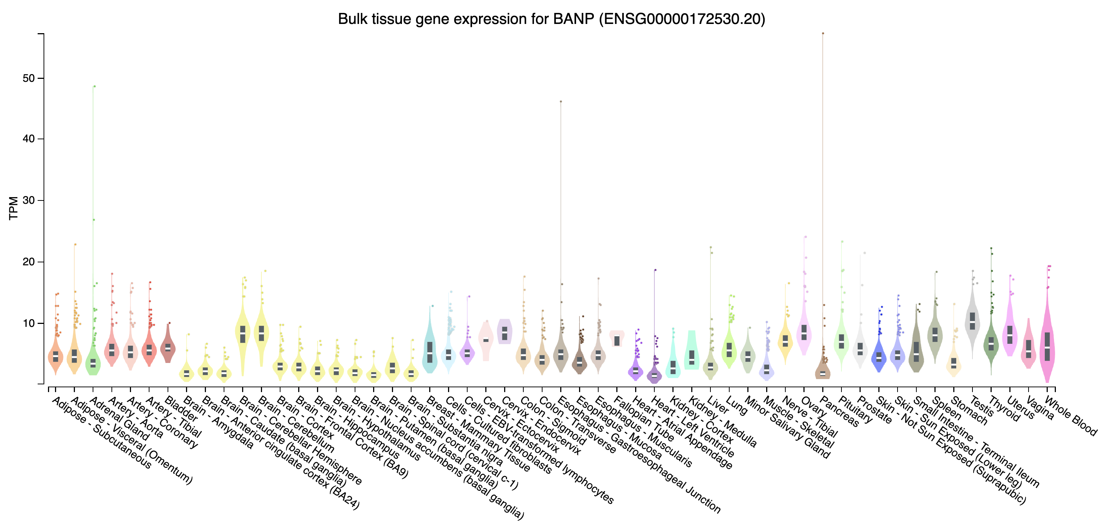
Human Gene Expression Profile

Slide 18
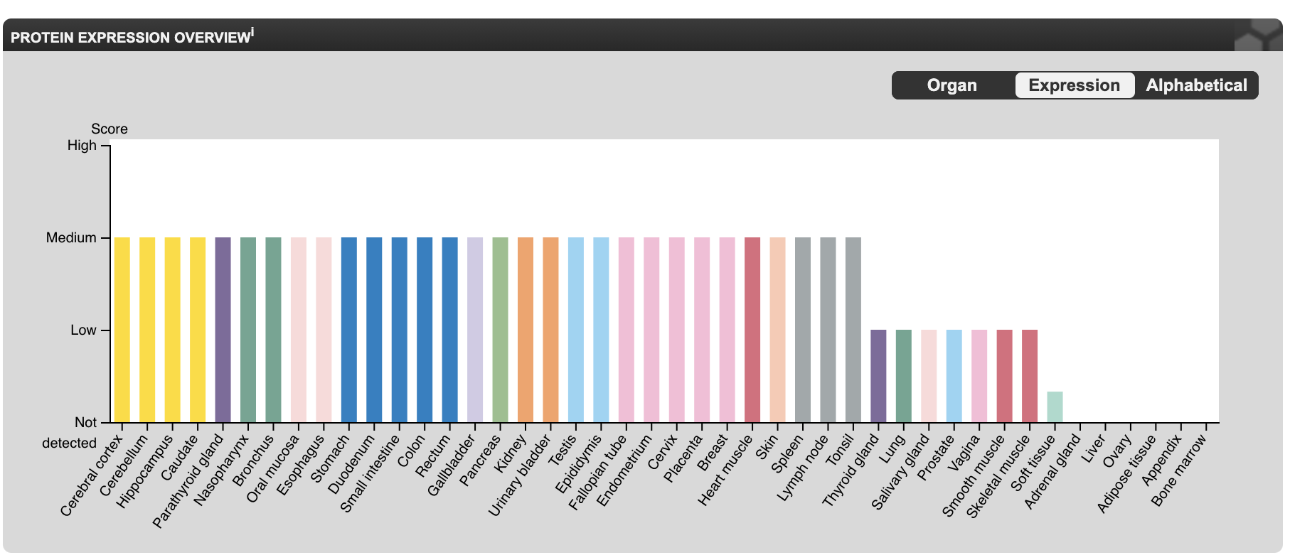
Human Protein Expression Profile

Slide 19
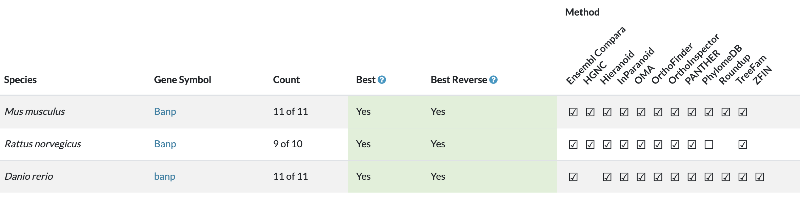
Modelability-Alliance Genome
MGI
http://www.informatics.jax.org/marker/MGI:1889023
Phenotypes: http://www.informatics.jax.org/marker/phenotypes/MGI:1889023 (from KOMP; single gene Knockout Mouse Project) https://www.jax.org/strain/033960
RGD
https://rgd.mcw.edu/rgdweb/report/gene/main.html?id=RGD:1307464
No rat model phenotypes
ZFIN
https://zfin.org/ZDB-GENE-050522-54
No zebrafish model phenotypes

Slide 20
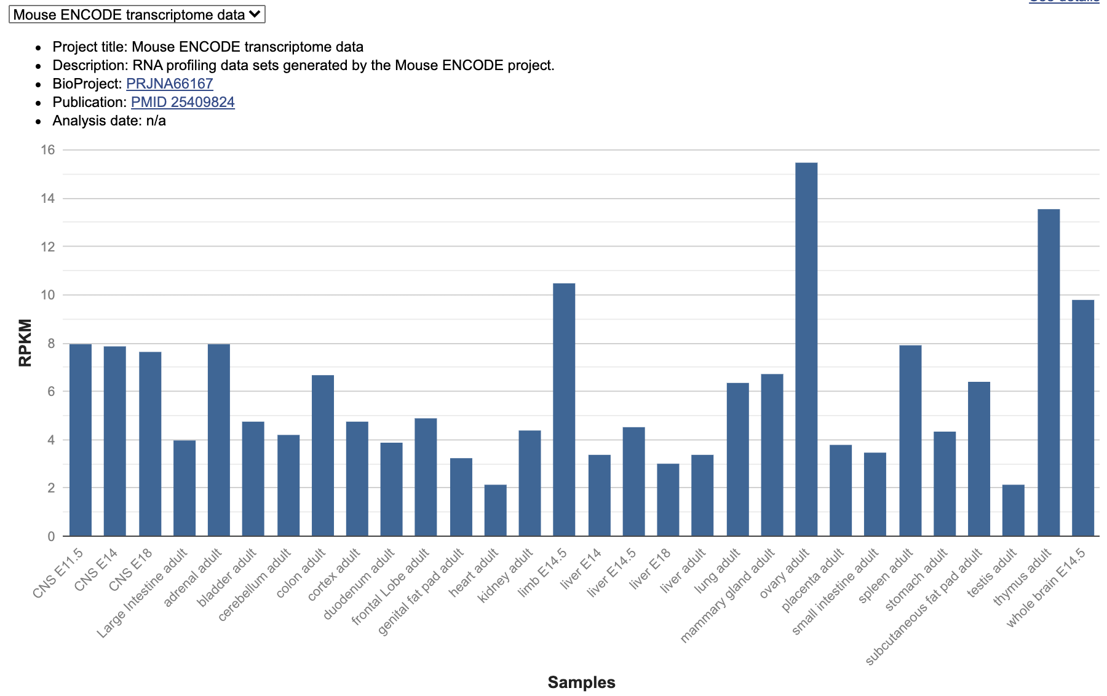
Model System Expression Profile

Slide 21
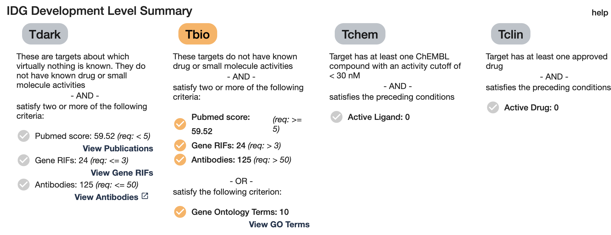
Druggability

Slide 22
Additional phenotype data
https://www.biorxiv.org/content/10.1101/2021.11.03.467208v1
CRISPR mutant

Slide 23
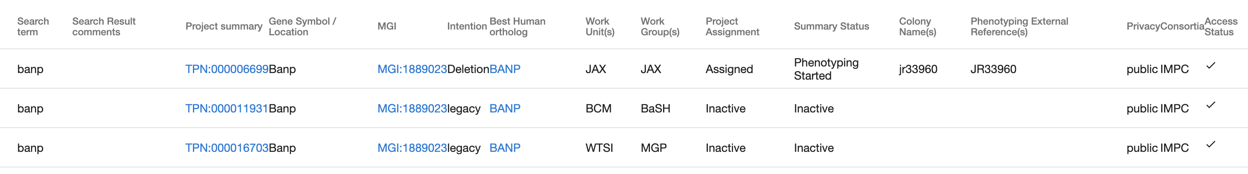
Modelability-GenTaR
GenTaR search https://www.gentar.org/tracker/#/
BCM:
"plan abandoned" https://www.gentar.org/tracker/#/projects/TPN:000011931
WTSI:
"attempt aborted" https://www.gentar.org/tracker/#/projects/TPN:000016703
JAX:
Attempt type "Crispr"
MI date "Mon Mar 04 2019"
Mutation type: "Banp^{em1(IMPC)J} Exon deletion"
Status: "Phenotyping started"
adult and embryo phenotyping underway"https://www.gentar.org/tracker/#/projects/TPN:000006699

